Slide 1
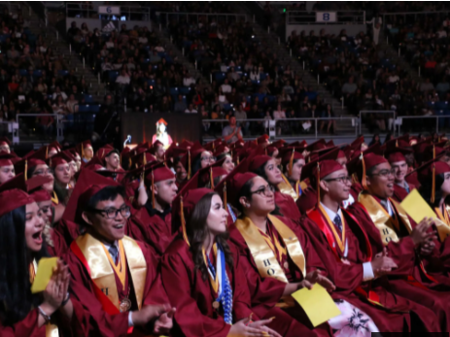

The SHS General
Scholarship Application

Slide 2
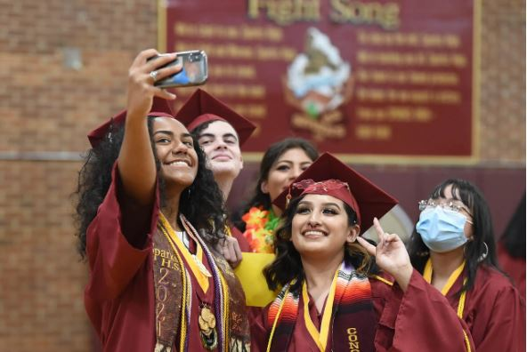
Only open to SHS Class of 2025
Multiple scholarships available ranging from $500 - $2000
Open to everyone: college, trade school, cosmetology, DACA/undocumented students,
Requirements
Application Form (On Career Center Web Page)
Opens
Dec 29, 2024
2 Scholarship Essays
Academic Resume
Proof of college/trade school acceptance

Slide 3
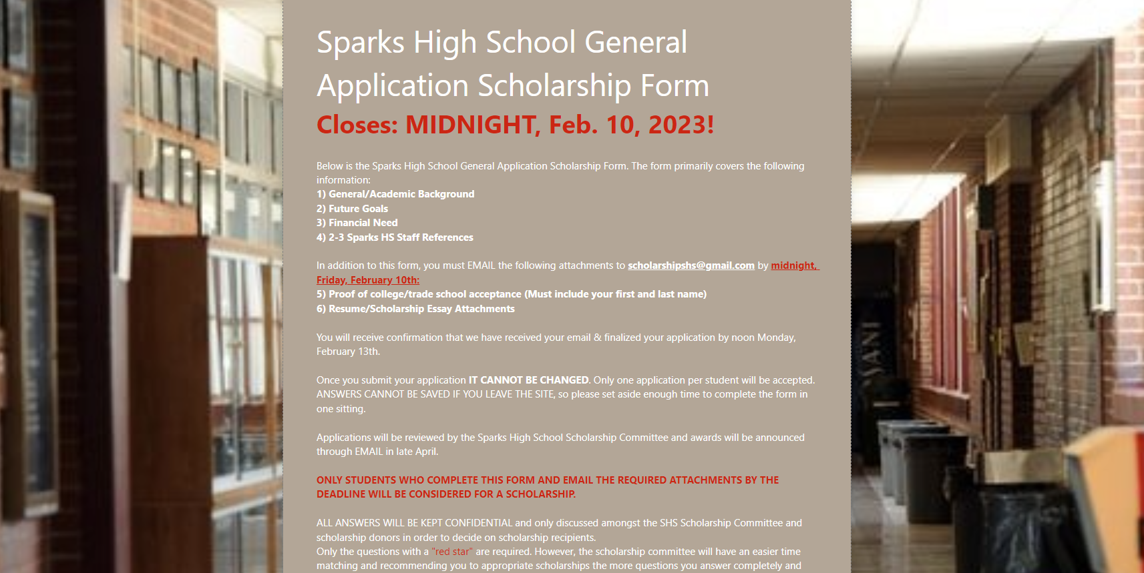
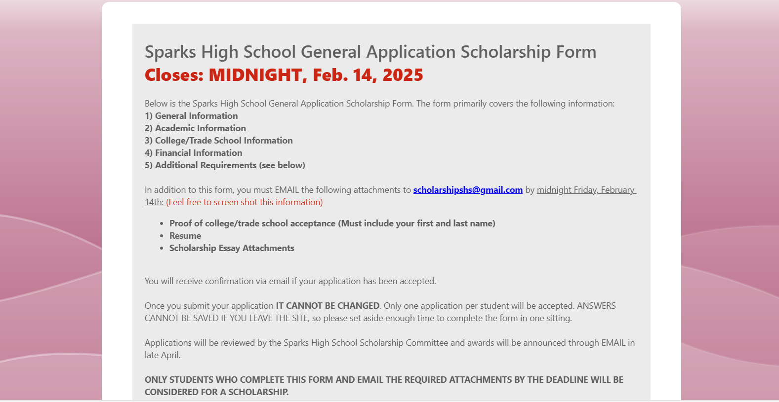
Must log in using the same things you use to log onto the school computers:
  StudentID@washoeschools.org
  Password
DO NOT “BORROW” A TEACHER’S OR A FRIEND’S LOG IN INFORMATION
Application
Form

Slide 4
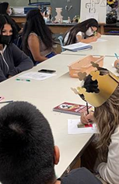
Essay Prompts
Write an essay about something specific you have done that you are proud of. It can be an academic accomplishment or a personal one. It can be about a particular achievement or something you have overcome. What is most important to us is that you describe what this achievement demonstrates about your character and your ability to be successful in higher education and in life.
Write an essay that summarizes your plans after high school and what steps you have taken to prepare for these goals. This can include your college, university, or trade school aspirations, and why you believe these are suitable institutions for you to attend. In addition, you can explain any financial or other circumstances that might hinder your ability to attend a school, and how receiving a scholarship might impact your loved ones and yourself.
***To be clear, we are not asking you to know exactly what you want to do or have your whole life figured out. Things change and so do you. Rather, we want to see that you have some ambition and vision for your future.***
600 word maximum (essays that are longer will be returned for revision in a timely manner)
MLA format
Emailed as either a Word document or PDF

Slide 5
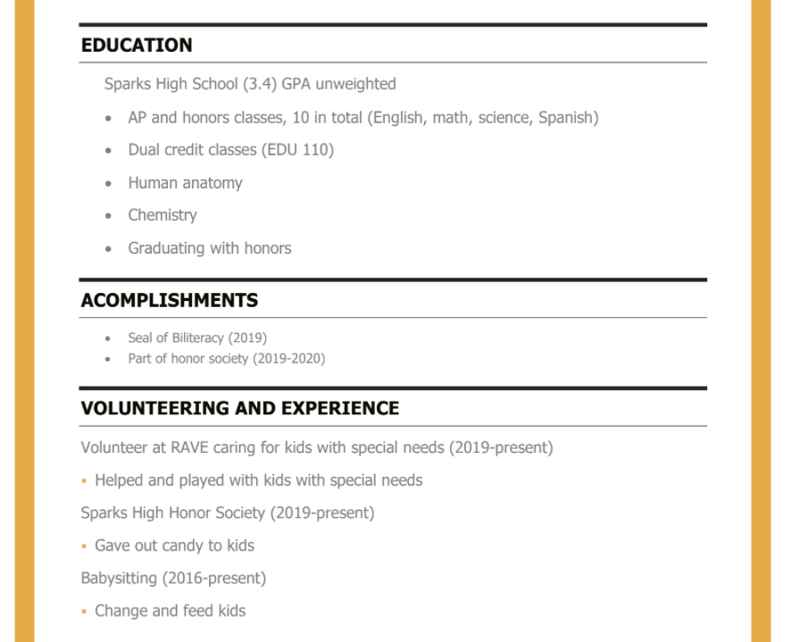
Academic
Resume
Focusing and highlighting your:
  Academic Achievement
  Participation
  Volunteerism
Reflect your post-high school goals and ambitions

Slide 6
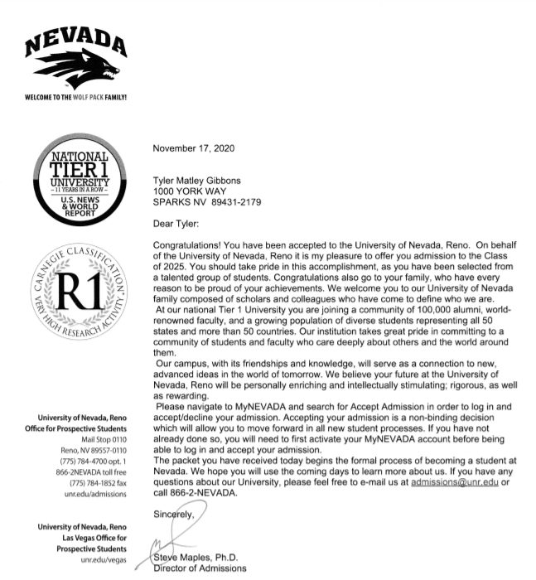

Proof
of Acceptance
Copy
Screenshot
Picture
Full Name
Name of school
+ New Student ID Number
DOES NOT HAVE TO BE THE SCHOOL YOU ULTIMATELY ATTEND

Slide 7
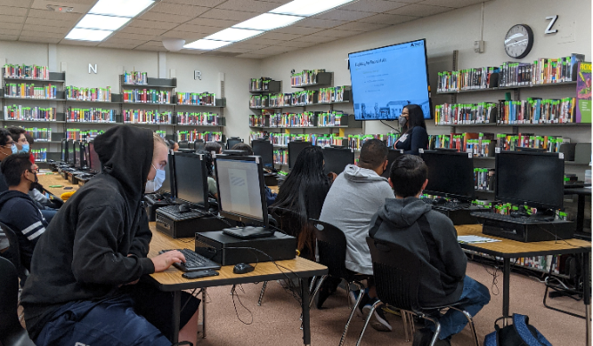
Need some help? Come to our. . .
Scholarship Clinics!
In the library
During WIN
Tuesdays and Thursdays in January
Help with:
Essays and Resumes

Slide 8
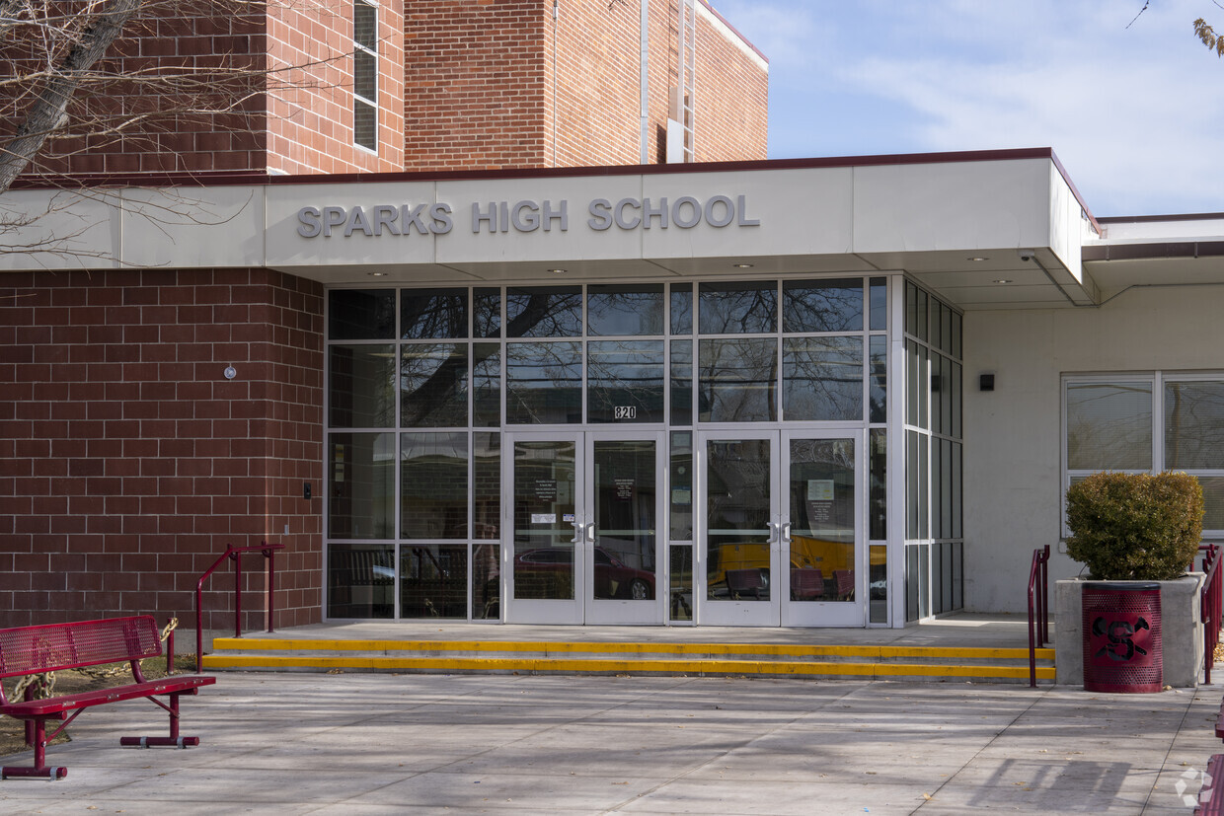

Where to get help!
Career Center​
Library ​
Tables during some days during lunch

Slide 9
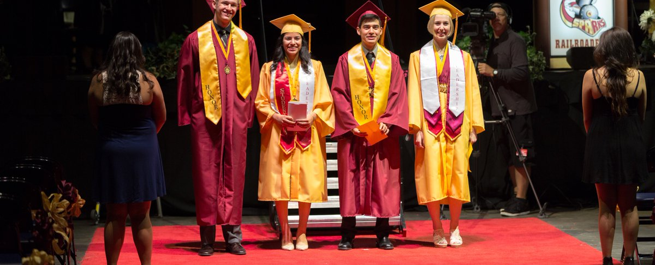
Opens
Dec 29, 2024
Application Form
2 Scholarship Essays
Academic Resume
Proof of college/trade school acceptance
Due by:
February
14, 2025
MIDNIGHT

